Slide 1



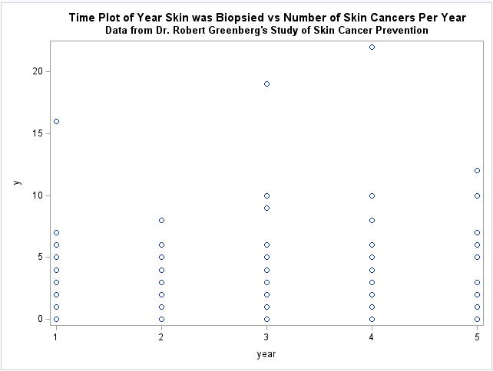
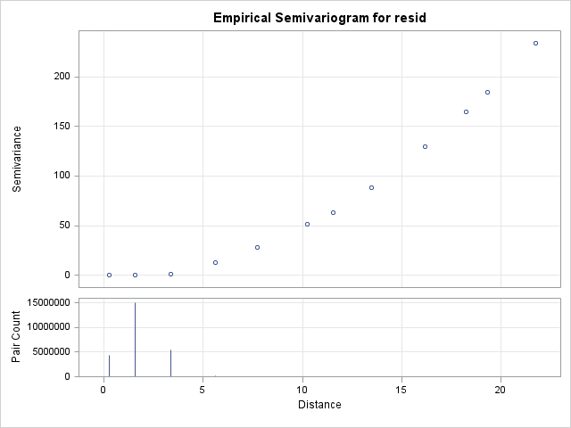
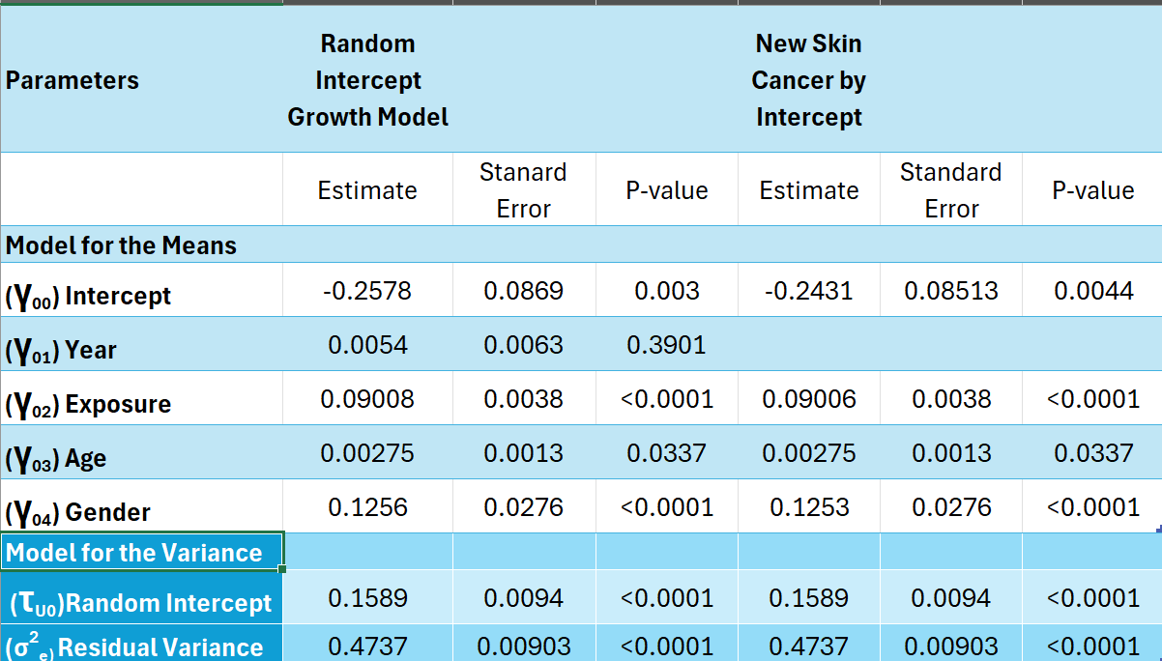
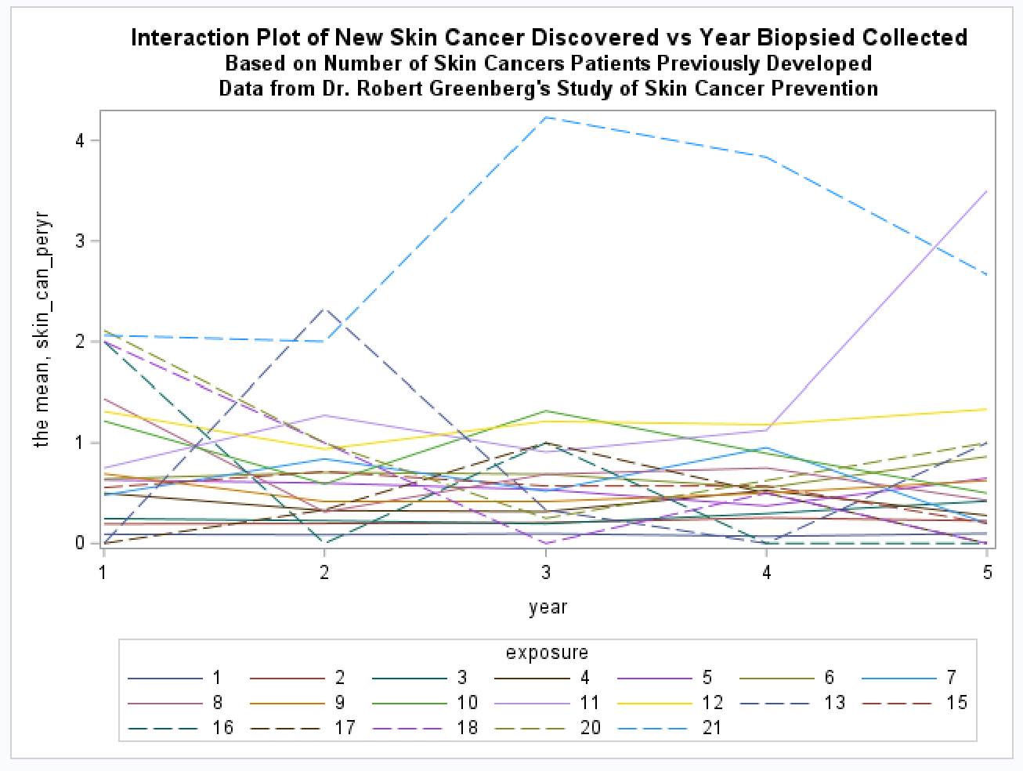
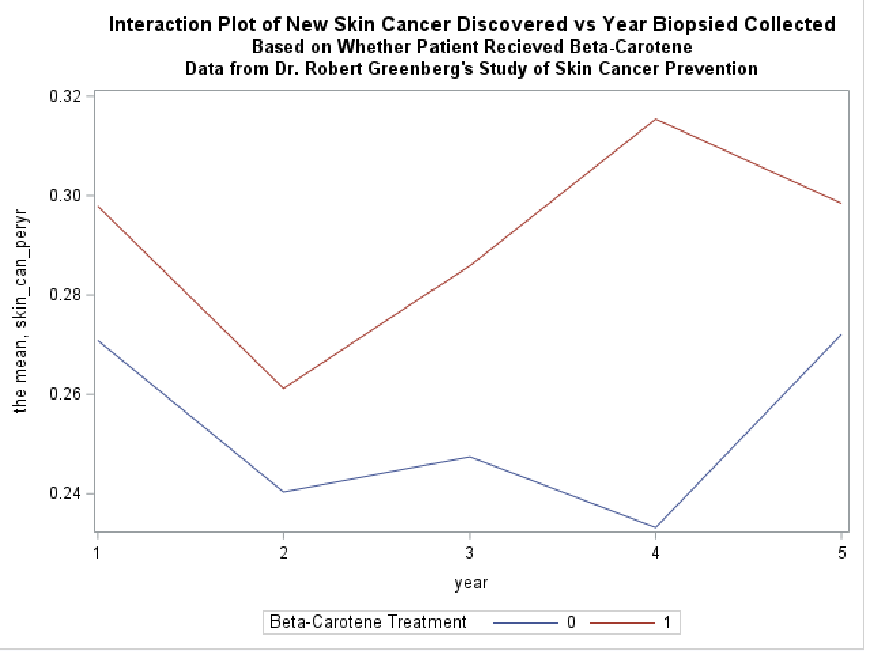
Non-melanoma Skin Cancer Prevention Ashton James and Martina Nesbeth – May 2025
Advisor: Dr. Lauren Matheny, PhD, MPH
INTRODUCTION
RESULTS
Non-melanoma skin cancer is a nonaggressive form of skin cancer that is common in the US. Participants in a clinical trial for beta- carotene were given the placebo or 50 mg of beta – carotene over 5 years to prevent the formation of skin cancer. The purpose of the study is to determine the amount of new skin cancer discoveries based on the past biopsies.
METHODS
The data is from the Skin Cancer Prevention Study and includes 7,081 observations and 2 occasions over the span of 5 years. The descriptive analysis utilized in the data are mean, answer key model, time plot, spaghetti plot, interaction plot and variogram. The mean provides the average of the variables. The answer key model provides a baseline model for the means and the variances. A time plot shows the variation between the year the skin was biopsied and the number of skin cancers per year. A spaghetti plot displays the variation and pattern between the new skin cancer being discovered and the year the biopsies were collected based on gender. An interaction plot show the correlation between treatment type and exposure level over years in relation to new skin cancers being discovered. A variogram displays the variability over time of new skin cancer being discovered and the year the biopsies were collected. A bottom – up approach was used to develop the model where variables were added in over time. An empty means model was built and the ICC told us that 35.02% of the data is accounted by level 2 variation. The criteria used to determine the best model fit is the p-value of the fixed effects.
Dependent Variables
Skin cancer per year – Amount of new skin cancer discovered per year
Independent Variables
Age – Age of participants (in years)
Assessing the likelihood of getting cancer based on a how old or young an individual is
Exposure – Number of prior skin cancers
Prior exposure increases the chances of having skin cancer again
Gender – Gender of participants
Seeing which gender is more likely to have skin cancer
Year – Year of follow up
Year allows us to see if any new skin cancers have developed
Model Notation:
Level 1:
y_{ti} = β_{0i} + e_{ti}
Level 2:
β_{0i} = γ₀₀ + γ₀₁Year + γ₀₂Exposure + γ₀₃Age + γ₀₄Gender + U_{0i}
RESULTS CONTINUED
The mean initially decreases but increases as time continues. The time plot indicates that as year increases, the number of skin cancer discoveries are less correlated. The interaction plot with exposure shows that exposure level and new skin cancer discoveries are correlated as the year increases. The interaction plot with treatment groups display that treatment 1 (beta-carotene) is higher over time versus treatment 2 (placebo). The variogram shows less variation over time of the new skin cancers. The table above represents a random intercept model, this means that time is not at random, but instead it is fixed. A random intercept model in this example means that at baseline, the discovery of new skin cancers discovered decreases by 0.2578 (~26%). The independent variables that are significant are Age, Exposure, and Gender. The older someone gets, the amount of new skin cancer discovered increases by 0.002 (0.2%). With the discovery of new skin cancer each year, the exposure level is increased by 0.09 (9%). For gender, women are more likely to develop new skin cancer ever year by 0.13(13%).
CONCLUSIONS
In this data, we created a random intercept model where the individual differences in the skin cancer per year are shown at baseline. The dependent variable was "new skin cancer found per year", denoted as "skin_can_peryr", using the independent variables age, exposure, gender, and year. The data had a lot of zeros which contributed to the time variable, denoted as year, to be not significant. Due to this issue, this would mean that there is no time component and only a random intercept in this longitudinal dataset. However, Age, Gender, and Exposure were significant. This makes this model a longitudinal model that better accounts for count dependent variables.

